Slide 1
A computational solution for bolstering reliability of epigenetic clocks: Implications for clinical trials and longitudinal tracking
Reporter: Je-Wei Chuang

Slide 2
Outline
Introduction
Methods
Results
Discussion

Slide 3
Introduction
Methods
Results
Discussion

Slide 4
Introduction
Biological age
DNA methylation
Epigenetic clocks based on DNA methylation
Existing clock: discrepancies between replicates
Limited use because of the large variation result from noise
Develop a clock with higher SNR to achieve higher reliability

Slide 5
Introduction
Methods
Results
Discussion

Slide 6
Naïve Solutions
Filtering out some CpGs
Only limited improvement
Priori knowledge needed thus not generalizable
Discarded CpGs likely contain important information
Weight based on ICC
Give higher weight on CpGs with higher ICC
Larger weight still amplify noise

Slide 7
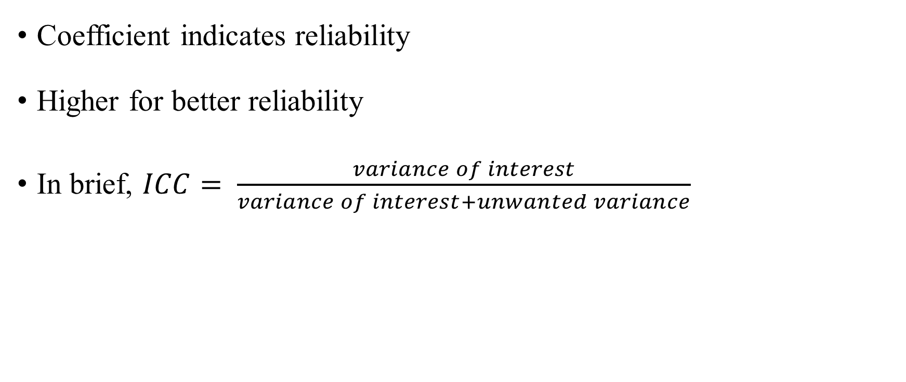
ICC – Inter Class Coefficient
Coefficient indicates reliability
Higher for better reliability
In brief, $ICC= \frac{variance of interest}{variance of interest+unwanted variance}$

Slide 8
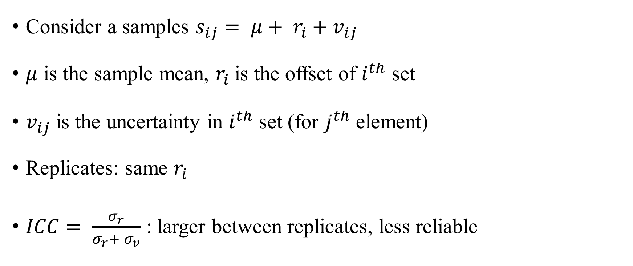
ICC – Inter Class Coefficient
Consider a samples $s_{ij}= μ+ r_{i}+v_{ij}$
$μ$ is the sample mean, $r_{i}$is the offset of $i^{th}$ set
$v_{ij}$is the uncertainty in $i^{th}$ set (for $j^{th}$ element)
Replicates: same $r_{i}$
$ICC= \frac{σ_{r}}{σ_{r}+ σ_{v}}$ : larger between replicates, less reliable

Slide 9
Key Observation
There are much more CpGs related than those used in existing clocks
Use PCA to extract covariance between CpGs
More information included
Low variance term can contain information
Elastic net regression remove noise effect

Slide 10
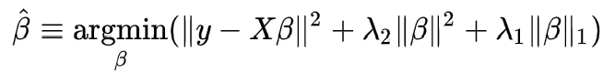
Elastic Net Regression
LASSO
Saturate for high-dimension few example
Suffers from linear corelated samples
Elastic net
Second order regularization term

Slide 11
Proposed Method
PCA projection
Elastic net regression removing noise
Do not remove too much low variance term by hand

Slide 12
Introduction
Methods
Results
Discussion

Slide 13
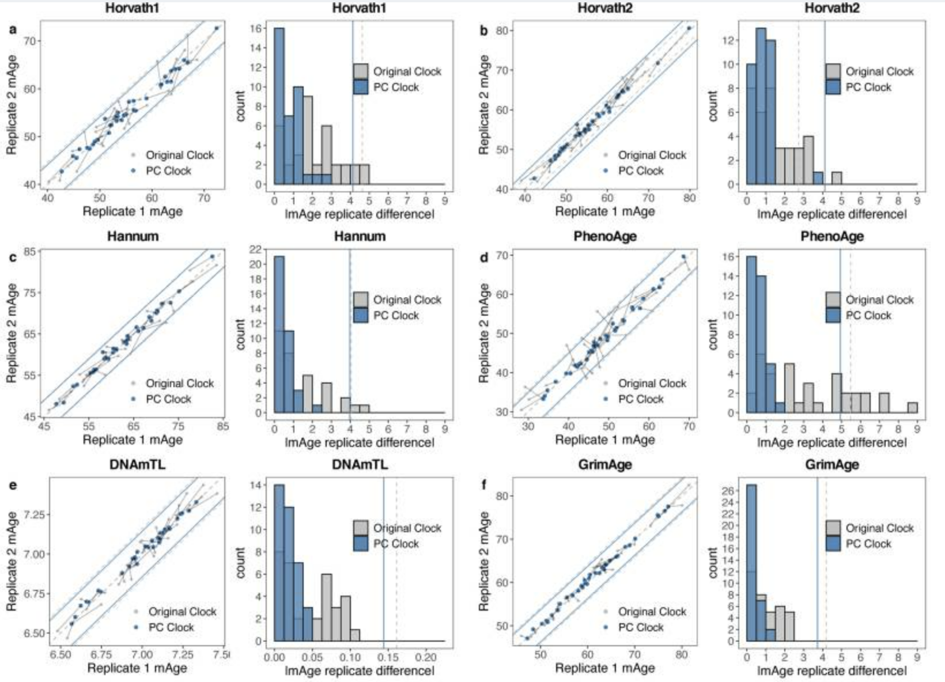
Results - Reliability

Slide 14
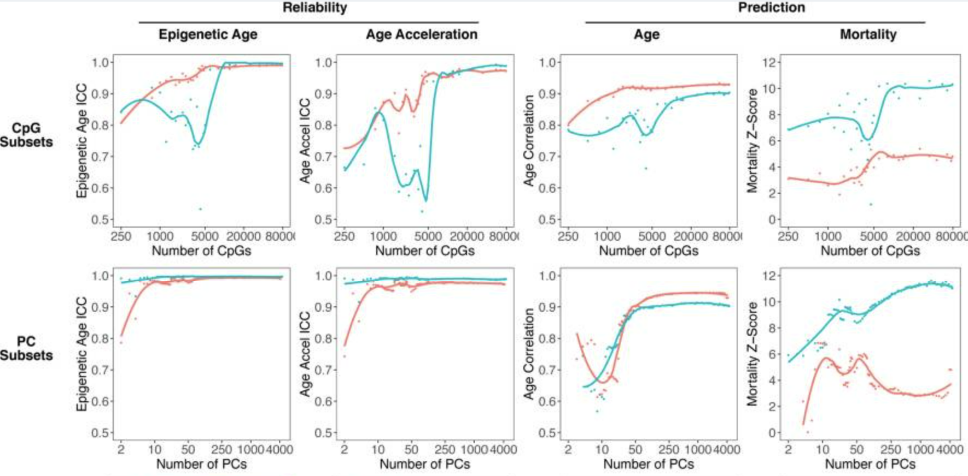
Results - Dimension

Slide 15
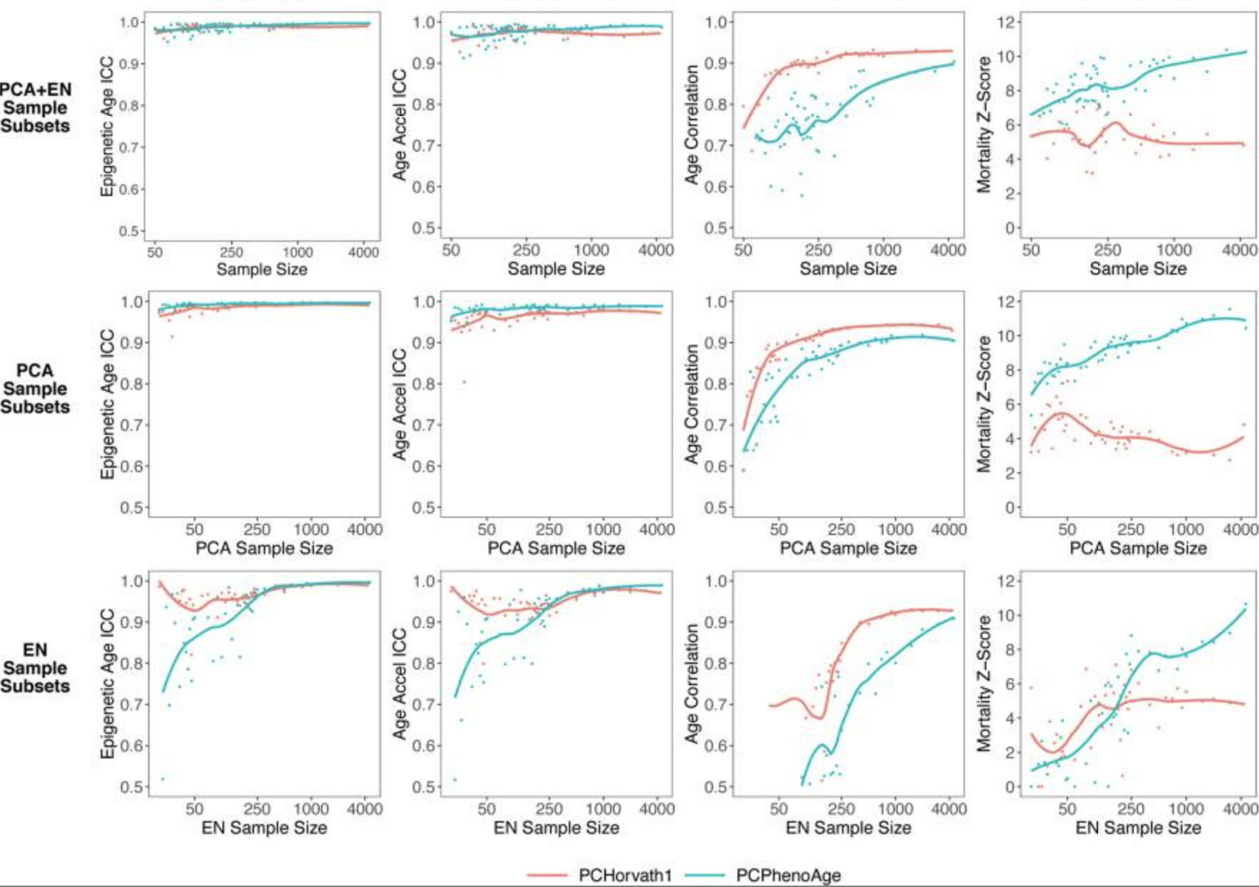
Results – Sample Size

Slide 16
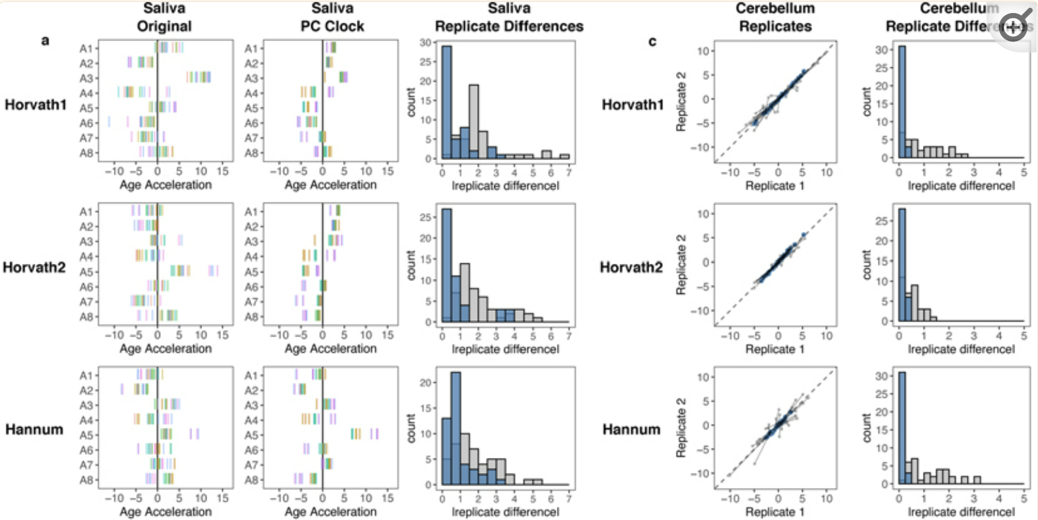
Results – Tissue

Slide 17
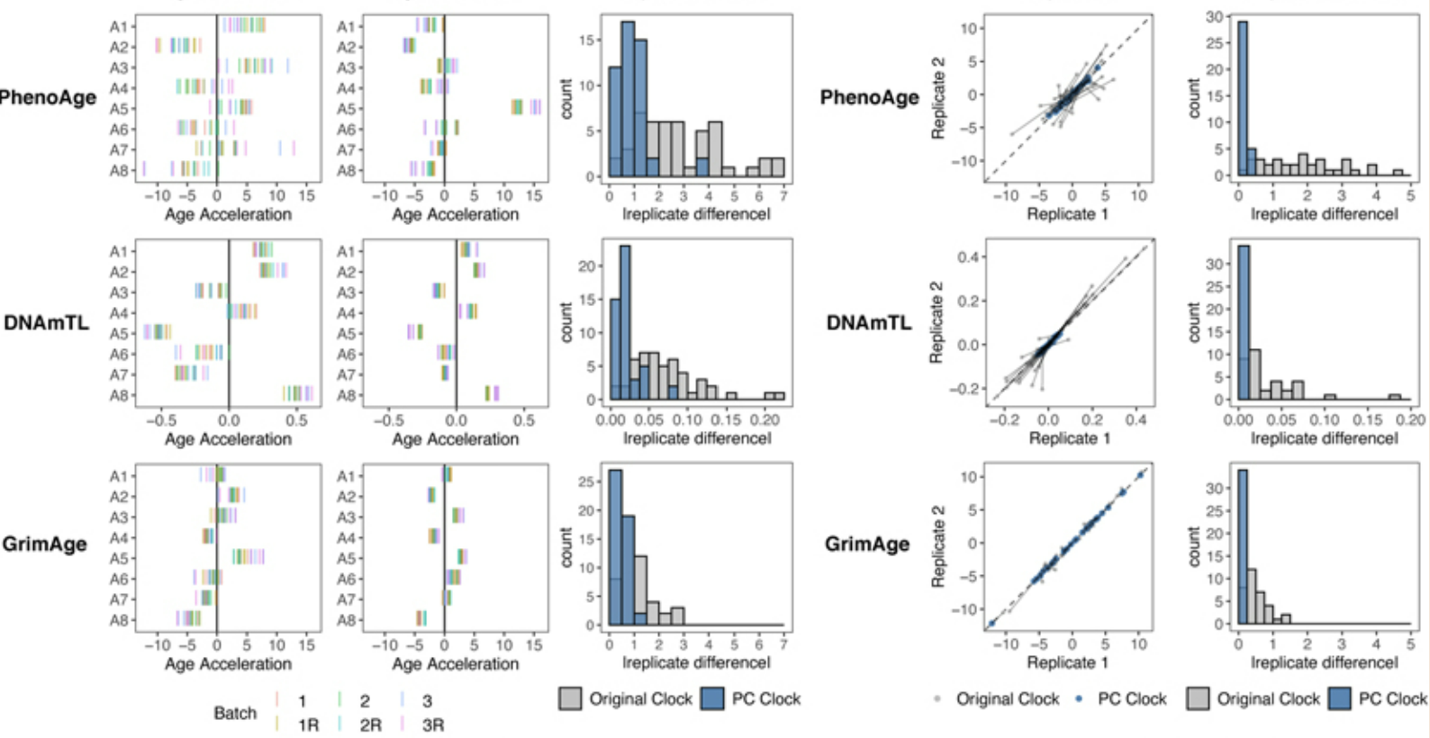
Results – Tissue

Slide 18
Introduction
Methods
Results
Discussion

Slide 19
Discussion
PCA separate noise from meaningful signals
Noise is not likely to appear only on PCs
Getting more information while avoids overfitting
Second machine learning step filter the noise

